Slide 1
Fundamentals of GenAI
PyTorch Primer
Tensors

Slide 2
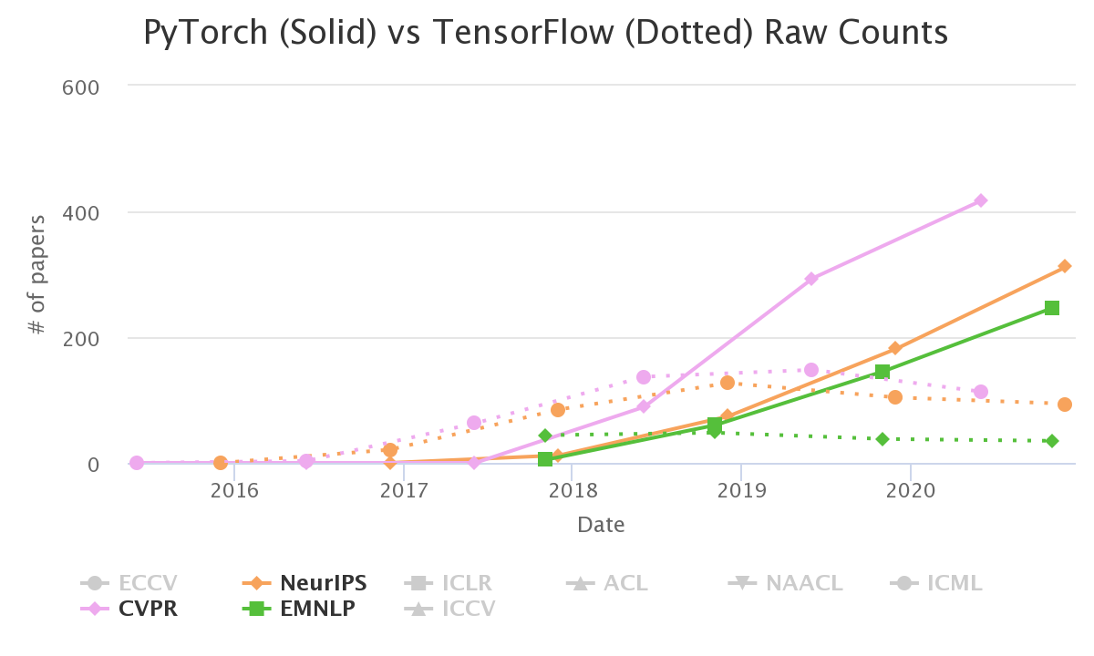
Why PyTorch?
Text Similarity
Source: horace.io/pytorch-vs-tensorflow/

Slide 3
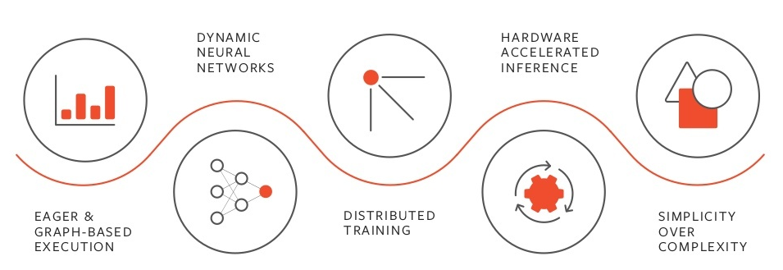
Text Similarity

Slide 4
A tensor is an N-dimensional data structure (data container)
Text Similarity
Rank 0 Tensor
scalar
Rank 1 Tensor
array, list, vector
Rank 2 Tensor
matrix
Rank 3 Tensor
Tensor dimension is not tensor shape !

Slide 5
Quick start with Jupyter Notebooks

Slide 6




Increasingly, data analysis and machine learning are carried out in self-descriptive, shareable, executable Jupyter notebooks
Explore, document, and visualize your data in one central notebook
Access additional tools like visualization libraries, machine learning APIs, and more
Present and collaborate with your peers through version controlled notebooks

Slide 7
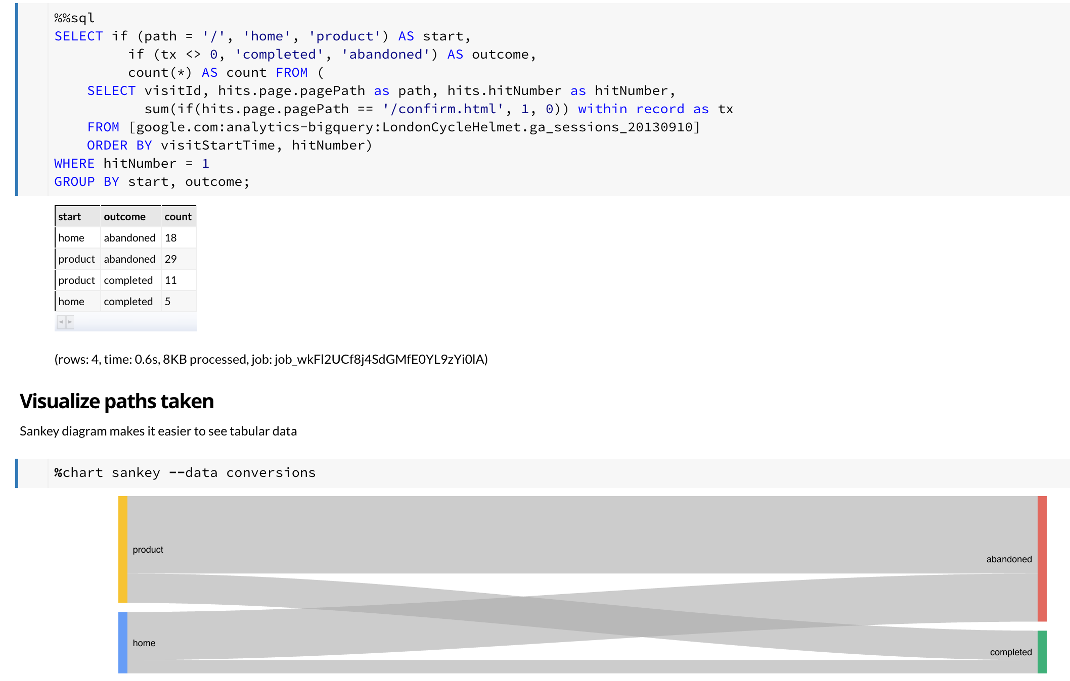
Notebook cells are the building blocks of a notebook
Executable Code (e.g. Python) or Text
Results
Visualizations

Slide 8


Command line shell magics in Jupyter notebooks
%%bash magic
Multiple shell commands in a single code cell
All shell command run in a single subprocess with a shared state
! (exclamation mark) magic
Shortcut for %%bash for a single shell command

Slide 9

Pitfalls of using Jupyter notebooks
Lack of continuous and active engagement
Read the notebook
Understand the notes and code
Experiment by modifying the code
Single-node architecture
Limited amount of memory
Kernel for the language runtime
Out-of-order evaluation
Code cells assume a state of the runtime

Slide 10

Demo
Text Similarity
PyTorch Tensors
Remember about PyTorch tensors

Slide 11
Lab
Text Similarity
PyTorch Tensors
Remember about PyTorch tensors

